Slide 1
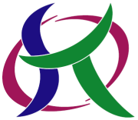
Machine learning in radiation metrology:
Consultancy Meeting on Machine Learning for Nuclear Data
Dec. 9, 2020 ONLINE meeting
Neutron spectrum unfolding and
Gamma-ray spectrometry
Kyushu University (Fukuoka, Japan)
Department of Advanced Energy Engineering Science
Tadahiro KIN

Slide 2
ML in radiation metrology
Contents
Overview of our ML application
in radiation metrology
ANN Neutron Spectrum Unfolding
Gamma-ray Spectrometry
Summary

Slide 3
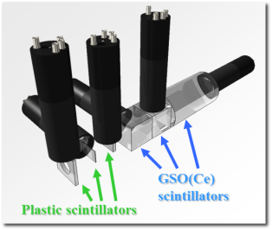
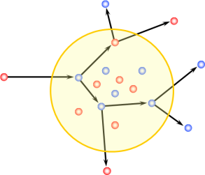
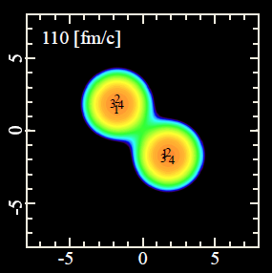
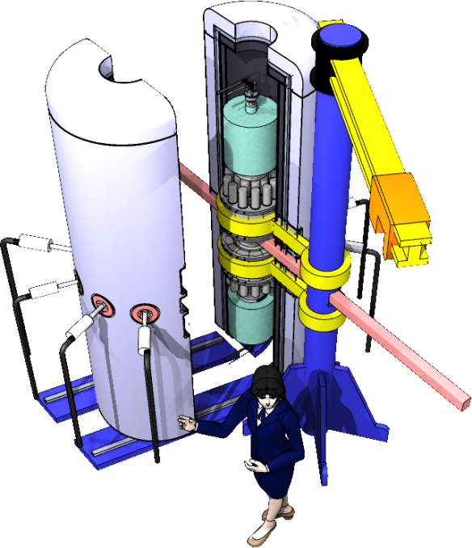
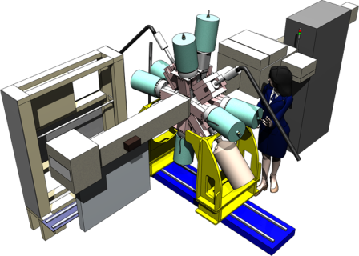
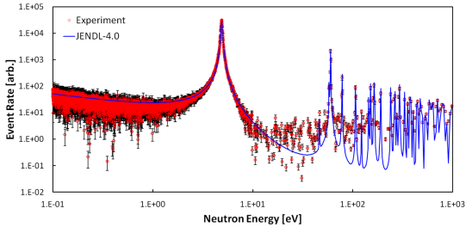
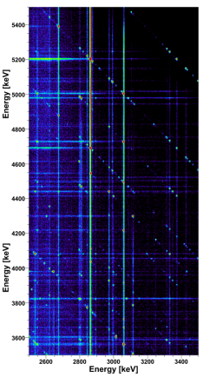
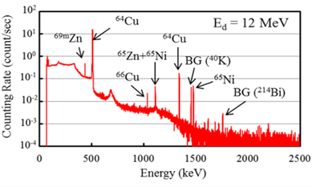
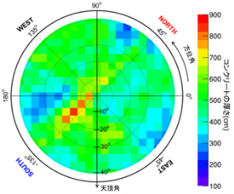
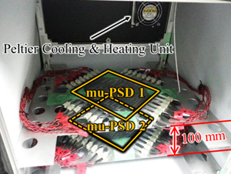
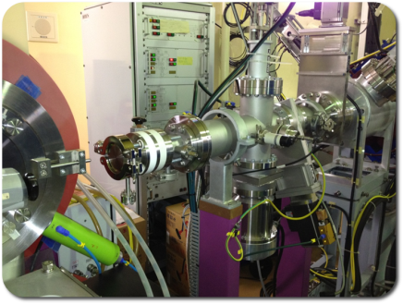
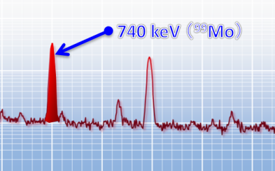
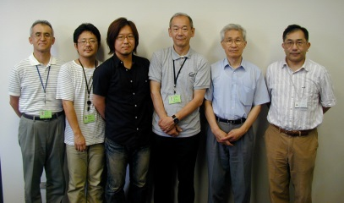
ML in radiation metrology
Self introduction: my research history
１） PhD Course （Kyushu Univ.）
２） 1st Postdoc （JAEA）
Cross section measurement of charged particle production by accelerator.
Development of theoretical calculation model (INC and AMD) of nuclear reaction.
Cross section measurement of thermal & cold neutron capture reaction.
Analysis of nuclear level structure.
Exp. at JRR-3 & J-PARC （JAEA）
Radiation Measurement
&
Detector Development
Exp. at Osaka Univ.
RI Production Method by Accelerator Neutron
Exp. at Kyushu and Tohoku Univ.
Cosmic-ray Muon Radiography (Muography)
Development of Medical RI Production Method by Accelerator Neutron
Exp. can be conducted everywhere on earth
Exp. at FNS & TIARA （JAEA）
４） Assistant / Associate Professor
３） 2nd Postdoc （JAEA）

Slide 4
ML in radiation metrology
Contents
Overview of our ML application
in radiation metrology
ANN Neutron Spectrum Unfolding
Gamma-ray Spectrometry
Summary

Slide 5
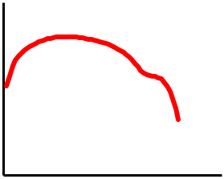
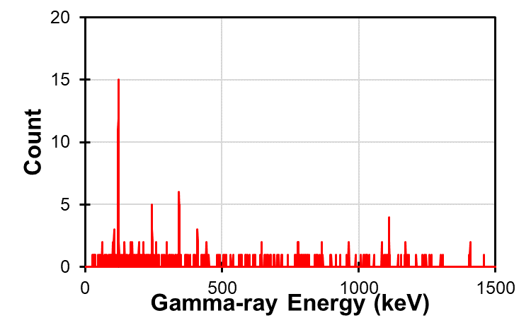
ML in radiation metrology
Today’s Topics
Neutron spectrum unfolding of
multiple-foils activation method
Induced activity
DDTTNY
²⁴Na: xxx Bq
⁵⁶Mn: xxx Bq
⁵⁹Fe: xxx Bq
⁵⁷Ni: ｘｘｘ Bq
⁶⁴Cu: xxx Bq
ML
model
Neutron Yield
Neutron Energy
2. Gamma-ray spectrometry
Gamma-ray spectrum
Activity
ML
model
¹³⁴Cs: xxx Bq
¹³⁷Cs: xxx Bq
⁶⁰Co: xxx Bq
¹⁵²Eu: ｘｘｘ Bq
¹⁵⁴Eu: xxx Bq

Slide 6
ML in radiation metrology
Today’s topics (details skipped)
3. Measurement of terrestrial cosmic-ray muon
spectrum around low energy range
Full-Absorption Muon Energy Spectrometer+ (FAMES+)
Kinetic energy: yyy MeV
Iron
Absorber
Deposit energy pattern is dependent to particle type and its energy.
Plastic
Scintillators
ML
model B
(regression)
Application of Japanese Patent
特願2019-160460 (Sep. 3, 2019)
Single event
deposit energies
ML
model A
(classification)
muon
1st layer: xxx MeV
2nd layer: xxx MeV
3rd layer: xxx MeV
electron
discard
(20% of total events)
…

Slide 7
ML in radiation metrology
Contents
Overview of our ML application
in radiation metrology
ANN Neutron Spectrum Unfolding
Gamma-ray Spectrometry
Summary

Slide 8
ML in radiation metrology
ANN Neutron Spectrum Unfolding: Background
Conventional Methods
Reactor-based Method:
  Produced by neutron irradiation or fission products
⁹⁹Mo
⁵⁹Co
(stable)
⁶⁰Co
(radioactive)
²³⁵U
n
n
+
+
Accelerator-based Method:
  Produced by charged particle induced reactions
Protons
Proton
Accelerator
¹⁸O
¹⁸O + p → ¹⁸F + n

Slide 9
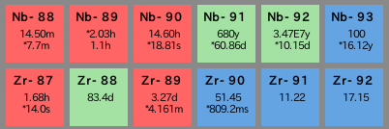
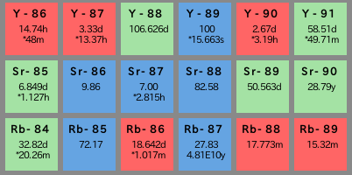
ML in radiation metrology
ANN Neutron Spectrum Unfolding: Background
Part of Generation of Radioisotopes with Accelerator Neutrons by Deuterons, Y. Nagai et al., J. Phys. Soc. JPN, 82, 064201 (2013).
Neutrons
Medical RI
Separation, Extraction
Deuterons
Deuteron
Accelerator
Neutron
Converter
Thick target made of C or Be
Raw
Material
Charged
Particle
Neutron
Accelerator based
Fast Neutron
Cross section multiplied twice,
but comparable amount can be produced, because large amount of target can be used.
Domestic Production
→ Stable supply system
New production route
→ Longer half-life PET
→ New therapeutic RI
Deuteron induced neutron → High intensity
Production route of charged particle reaction
Adjustable neutron energy distribution
→ high purity, efficient
Irradiation material
→ Large amount
→ Free chemical form
The route of
neutron induced RI

Slide 10
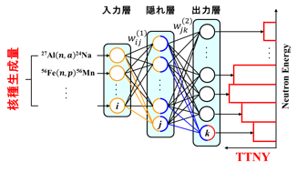
ML in radiation metrology
ANN Neutron Spectrum Unfolding: Objective
Systematic nuclear data measurement of DDTTNY via the C and Be (d,n) reactions
  for estimation of production amount, impurities,
  and design of irradiation system
  Multiple-foils activation method. → Unfolding process
    Development of ANN unfolding code (2016)
AVF930 Cyclotron, CYRIC, Tohoku Univ. (JPN)
Our 1st ML application
(IEEE NSS/MIC 2017)
Using very simple ANN model,
but has sufficient performance.
Using no open library (for our education)
e.g., High purity ⁶⁴Cu production T. Kin, et al., J. Nucl. Sci. Tech. 54 (2017) 1123.

Slide 11
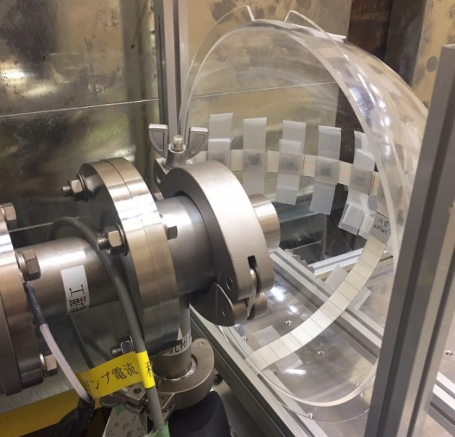
ML in radiation metrology
ANN Unfolding Code
Multiple-foils activation method
multiple foils
Precise absolute value:
Based on a lot of reliable integral experiments. Detectors are uniform (determined by natural abundance).
Precise angular-differential TTNY:
Irradiation of all angles at same time. Beam current measurement.
Low energy resolution:
No problem, because both DDTTNY and neutron excitations of focused reactions are smooth.
C or Be
thick target
deuteron
Placed from 0 to 75deg. (in15deg. step)
Irradiation foils
Output of the method is numbers of produced atoms measured by gamma-ray spectrometry
Mo
Zr
Zn
Co
Ni
2cm
Al
1cm
Energy-differential neutron yield
Fe
Au
Unfolding Process

Slide 12

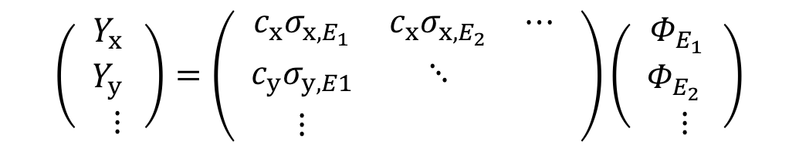

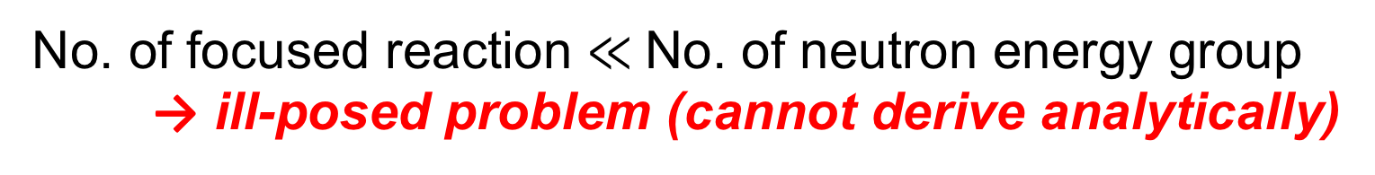




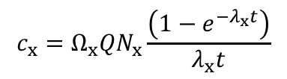

ML in radiation metrology
ANN Unfolding Code
Neutron spectrum unfolding
$$\left( \begin{matrix}Y_{x,x} \\ Y_{y,y} \\ ⋮\end{matrix}\right)=\left( \begin{matrix}{c_{x}σ}_{x,E_{1}} & c_{x}σ_{x,E_{2}} & ⋯ \\ {c_{y}σ}_{y,E1} & ⋱ & \\ ⋮ & & \end{matrix} \right)\left( \begin{matrix}Φ_{E_{1}x} \\ Φ_{E_{2},y} \\ ⋮\end{matrix}\right)$$
$$c_{x}={Ω_{x}QN}_{x}\frac{\left(1−e^{−λ_{x}t}\right)}{λ_{x}t}$$
$$x$$
: ID of activated nuclide
$$σ$$
: Cross section
$$N$$
: Surface No. density of target
Yield at EOI
Obtained by gamma-ray spectrometry
Response function
using nuclear data library
JENDL-4.0 or EAF2010
$$Ω$$
DDTTNY
to be derived
: Solid angle
$$Q$$
: Total beam charge
$$t$$
: Irradiation time
$$λ$$
: Decay constant
No. of focused reaction $≪$No. of neutron energy group
→ ill-posed problem (cannot derive analytically)
Constant
Unfolding
solving inverse problem
TTNY
Initial Guess DDTTNY
If needed, calculated DDTTNY by DEURACS* was used.
(Note that our ANN code not requires)
*S. Nakayama et al. Phys. Rev. C 94, 014618 (2016).

Slide 13
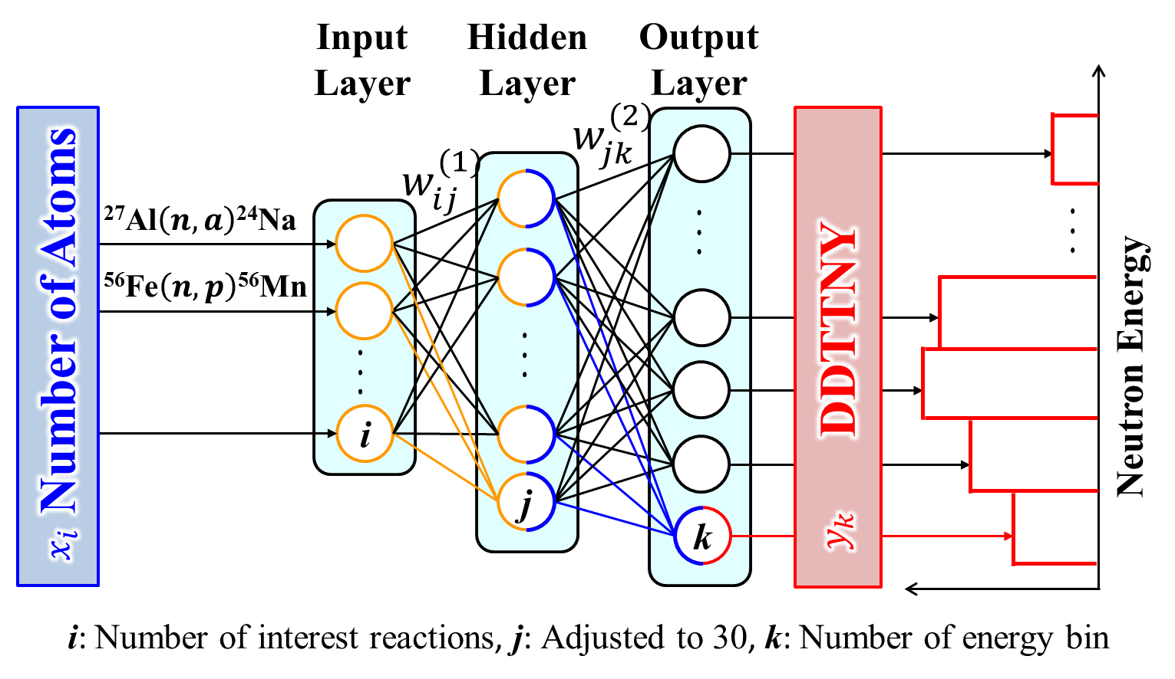
ML in radiation metrology
ANN Unfolding Code
Developed ANN unfolding code
Simple fully-connected feedforward neural network is sufficient ← independent input data & one-dimensional output

Slide 14
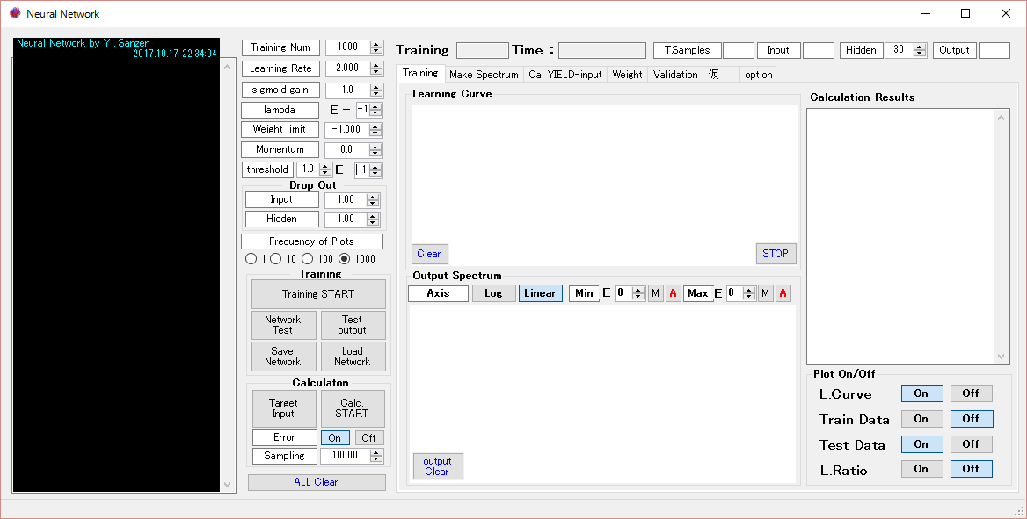
ML in radiation metrology
ANN Unfolding Code
Developed ANN unfolding code
No open ML library used (not to be a black box user)
Training data (self-producible gaussian + EXFOR)

Slide 15
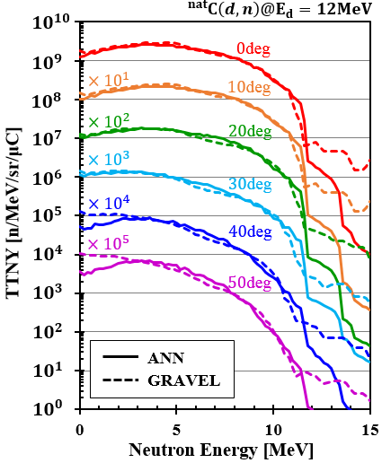
ML in radiation metrology
Results and discussion
GRAVEL (SAND-II upgrade ver.)：
Conventional unfolding code.
having more than 50 years history.
(broken lines)
ANN：
Present results (solid lines)
GRAVEL code requires initial guess DDTTNY and convergence condition should be artificially determined.
Present ANN-based code requires no initial guess and convergence condition but has same performance with GRAVEL.

Slide 16
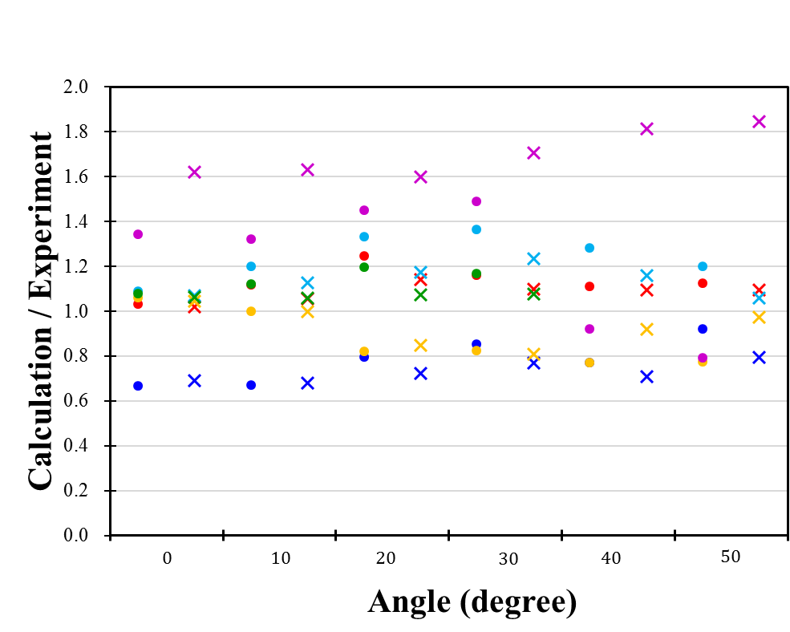
ML in radiation metrology
Results and discussion
Folding calculation (C) over activity obtained in the experiment (E).
ANN
GRAVEL
²⁷Al(n,α)^{24g}Na
⁵⁸Ni(n,p)^{28g}Co
⁵⁶Fe(n,p)⁵⁶Mn
¹⁹⁷Au(n,2n)¹⁹⁶Au
¹⁹⁷Au(n,γ)¹⁹⁸Au
⁵⁹Co(n,α)⁵⁶Mn
Average Standard Deviation of C/E for all reactions and angles:
  ANN: 21.1 % (19.4% w/o ¹⁹⁷Au(n,γ))
  GRAVEL: 31.3% (15.8% w/o ¹⁹⁷Au(n,γ))

Slide 17
ML in radiation metrology
Contents
Overview of our ML application
in radiation metrology
ANN Neutron Spectrum Unfolding
Gamma-ray Spectrometry
Summary

Slide 18






ML in radiation metrology
Gamma-ray Spectrometry: Background
Gamma-ray spectrometry by ML
Spreading by
Meteorological
phenomena
Fukushima Daiichi Nuclear Plant Accident
Release to the air
Fallout
Direct pollution
of agricultural crops
Barn animal
Distant
area
Leakage to the sea
Absorption and diffusion to soil
Leach into groundwater
Huge number of samples must be measured,
and in many cases, the sample has low activity.
Accumulation to bed
  → To confirm “ND,” long measurement time is required.
Key is “automation “ and “rapidity.” … ML has potential.

Slide 19
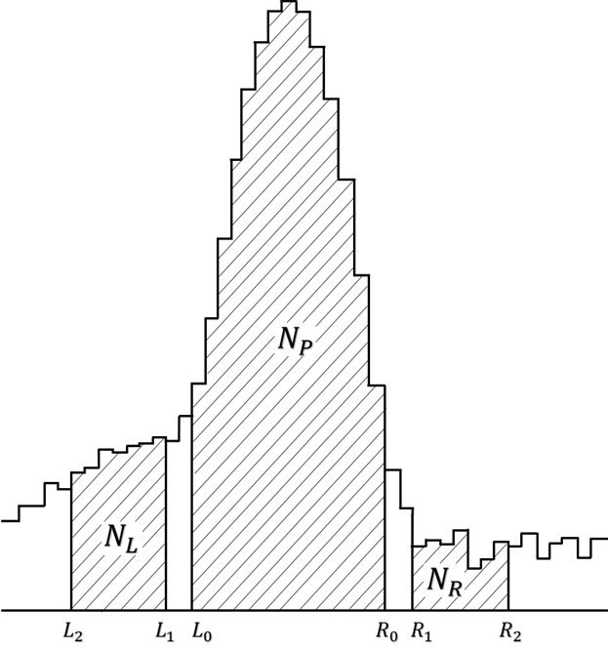
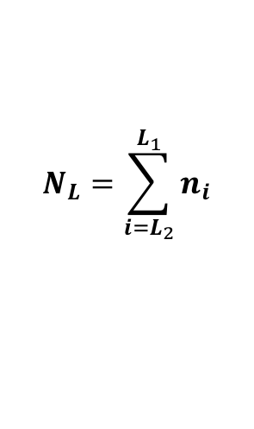
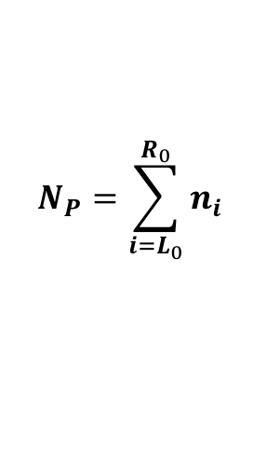
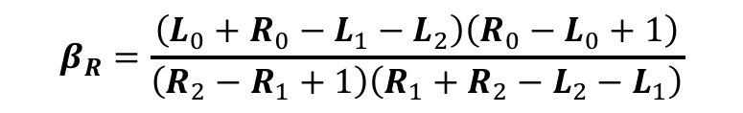
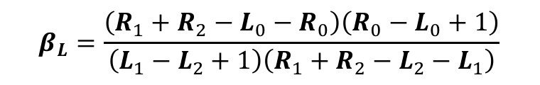

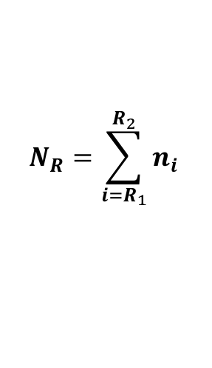
ML in radiation metrology
Gamma-ray Spectrometry: Methods
Conventional Method: Covell Method
Simple linear estimation method to subtract background component under an interested photo peak
  → implemented on all gamma-ray spectrometry software.
$$N_{net}=N_{P}−β_{L}N_{L}−β_{R}N_{R}$$
$$β_{R}=\frac{\left(L_{0}+R_{0}−L_{1}−L_{2}\right)\left(R_{0}−L_{0}+1\right)}{\left(R_{2}−R_{1}+1\right)\left(R_{1}+R_{2}−L_{2}−L_{1}\right)}$$
$$β_{L}=\frac{\left(R_{1}+R_{2}−L_{0}−R_{0}\right)\left(R_{0}−L_{0}+1\right)}{\left(L_{1}−L_{2}+1\right)\left(R_{1}+R_{2}−L_{2}−L_{1}\right)}$$
$$N_{P}=\sum_{i=L_{0}}^{R_{0}}{n_{i}}$$
$$N_{L}=\sum_{i=L_{2}}^{L_{1}}{n_{i}}$$
$$N_{R}=\sum_{i=R_{1}}^{R_{2}}{n_{i}}$$

Slide 20
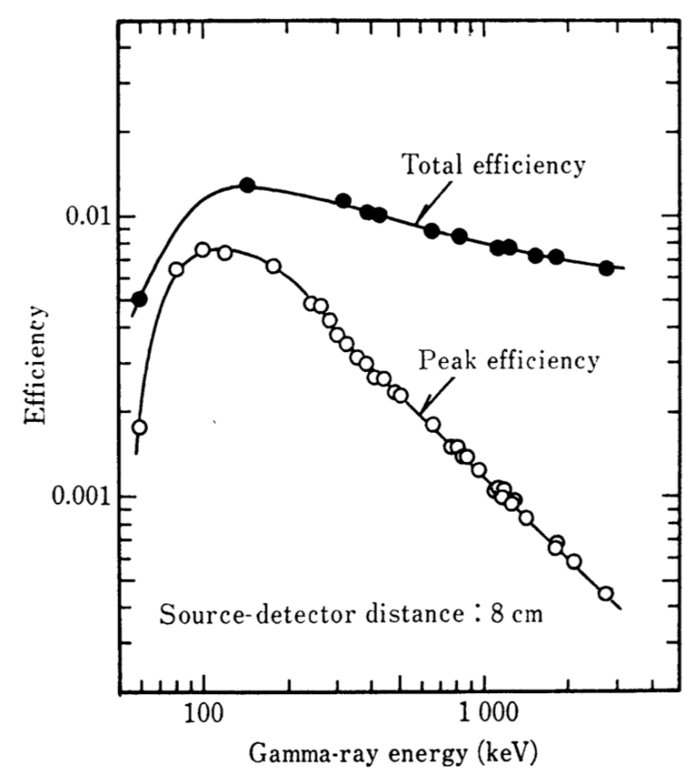
ML in radiation metrology
Gamma-ray Spectrometry: Methods
How can we reduce measurement time?
As long as using only photo peak, no method drastically improve measurement time of Covell method.
If discarded events in Covell method can be taken into account, 3 times faster measurement is possible (ideally).
Ge detector efficiency
UNFOLDING!!
Once we achieved around 10 times faster measurement of NaI(Tl) gamma-ray spectrometry by the iterative unfolding method (awarded by Minister of the environment of Japan in 2015)
Any codes are okay, but we have experience of successful unfolding by ML model (as shown before).
511 keV
(annihilation)
662 keV
(¹³⁷Cs)

Slide 21
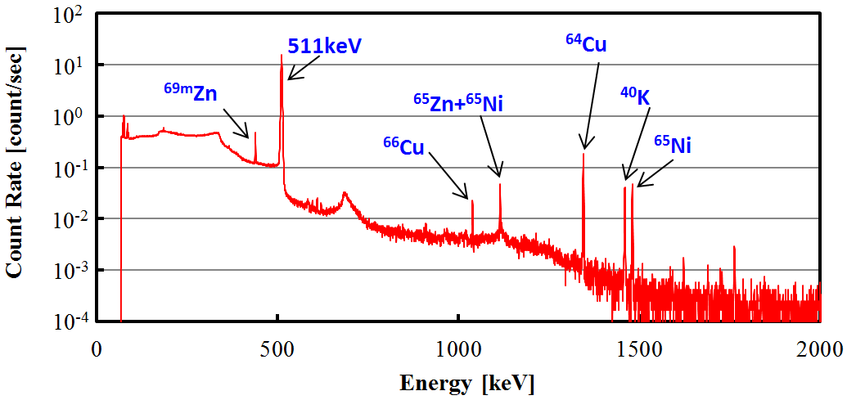
ML in radiation metrology
Gamma-ray Spectrometry: Methods
Spectrum “shape” has information
→ Convolutional Neural Network (CNN) is promising.
Photo peak
Compton component ends
Doublet

Slide 22
ML in radiation metrology
Gamma-ray Spectrometry: Methods
R. Takahashi (M1 student) coded everything last year for his bachelor thesis
Activity prediction of ¹³⁷Cs including ¹³⁴Cs and ⁴⁰K
(random activity for each nuclide, fixed measurement time 60s)
Tensorflow + keras
to develop the ML model
Using GPU server machine
having 2 boards of Geforce RTX 3020
Convolution
Pooling
¹³⁷Cs
Activity
Training and validation data sets were prepared by Geant4 simulation
Pooling
Convolution
Pooling
Loss: MSE

Slide 23
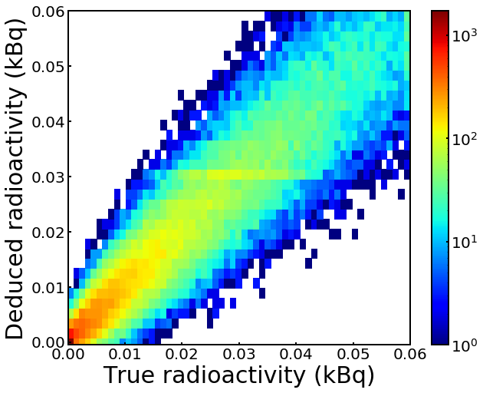
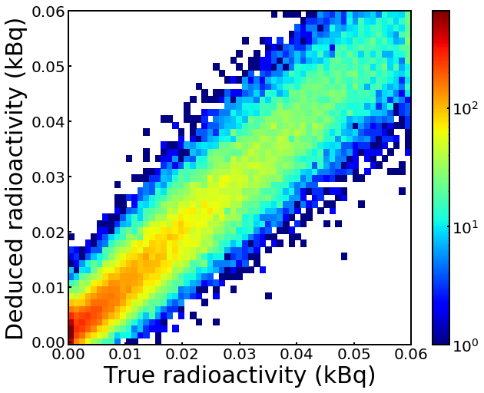
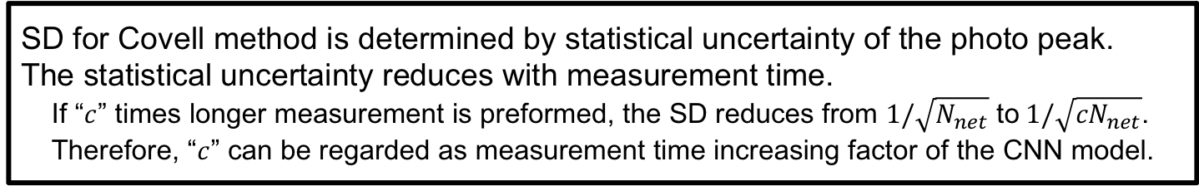
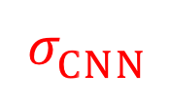

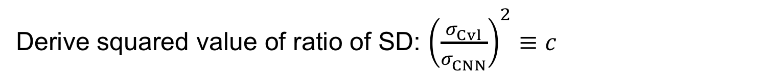
ML in radiation metrology
Results and discussion: ¹³⁷Cs
Covell method
Present CNN model
$$σ_{Cvl}^{}$$
$$σ_{CNN}^{}$$
Preliminary
Preliminary
Measurement time of the data set was fixed to 60 sec.,
thus the following analysis method proposed
Derive squared value of ratio of SD: ${\left(\frac{σ_{Cvl}^{}}{σ_{CNN}^{}}\right)}^{2}≡c$
SD for Covell method is determined by statistical uncertainty of the photo peak.
The statistical uncertainty reduces with measurement time.
If “$c$” times longer measurement is preformed, the SD reduces from $1/\sqrt{N_{net}}$ to$1/\sqrt{{cN}_{net}}$.
Therefore, “$c$” can be regarded as measurement time increasing factor of the CNN model.

Slide 24
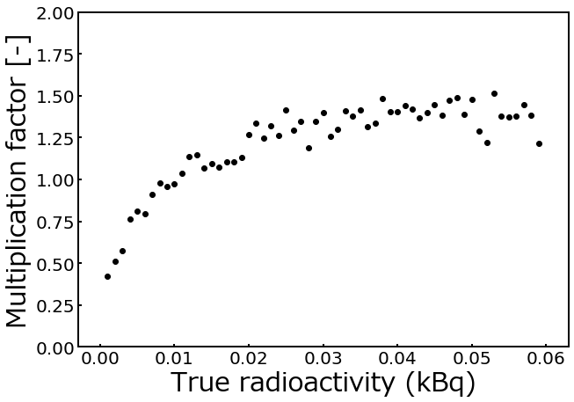
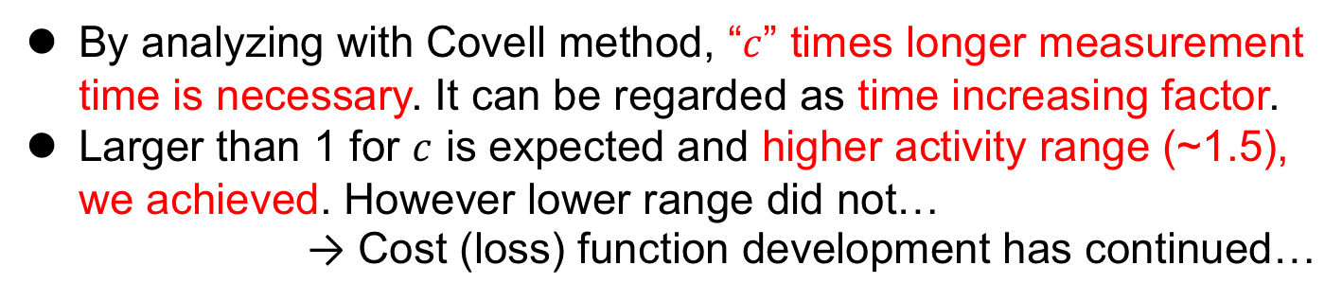
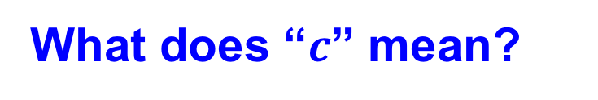
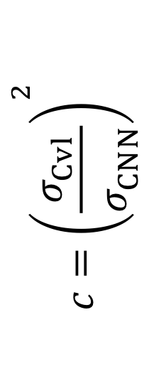
ML in radiation metrology
Results and discussion: ¹³⁷Cs activity
Preliminary
$${c=\left(\frac{σ_{Cvl}^{}}{σ_{CNN}^{}}\right)}^{2}$$
What does “$c$” mean?
By analyzing with Covell method, “$c$” times longer measurement time is necessary. It can be regarded as time increasing factor.
Larger than 1 for $c$ is expected and higher activity range (~1.5), we achieved. However lower range did not…
→ Cost (loss) function development has continued…

Slide 25
ML in radiation metrology
Contents
Overview of our ML application
in radiation metrology
ANN Neutron Spectrum Unfolding
Gamma-ray Spectrometry
Summary

Slide 26
ML in radiation metrology
Summary
ML application for neutron spectrum unfolding of
multiple-foils activation method
Simple fully-connected feedforward NN model
  gives sufficient unfolding results compared with those of conventional one,
  even it requires no initial guess and human inducible convergence condition.

Slide 27
ML in radiation metrology
Summary
Gamma-ray spectrometry
Convolutional Neural Network
CNN model
Covell method
  may use also non-photo peak events for higher activity samples,
  may not directly count photo-peak events, considering the worse performance around lower activity sample.
Preliminary

Slide 28
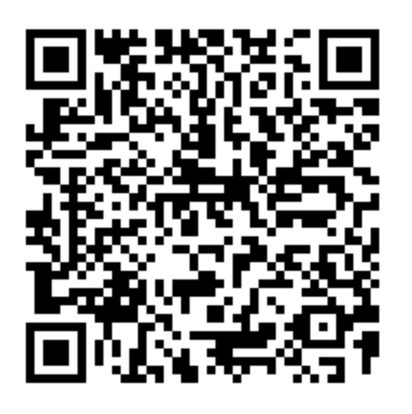
ML in radiation metrology
Thank you for your attention.
Questions and/or Comments?
CNN model
Covell method
Preliminary
Tadahiro KIN, Kyushu Univ. (Japan)
e-mail: kin.tadahiro.981@m.kyushu-u.ac.jp

